Slide 1
Indexing Fundamentals
Ayman El-Ghazali
www.TheSQLPro.com @TheSQLPro

Slide 2
Agenda
What is the purpose of an Index?
Heaps and the B-Tree Structure
Non-Clustered Indexes and Optimizing Queries
Clustered vs. Non-Clustered Index
Creating Indexes
Fragmentation
Fill Factor and Padding
Maintenance
Benefits/Drawbacks of Indexes

Slide 3
Purpose of an Index
To store data in an organized fashion
This allows for faster querying of data
Additionally, allows for faster querying with joins where join columns are indexed
It's all about making queries faster!
However, understand that indexes may make reads faster but writes will be slower

Slide 4
Heap - Table without Clustered Index
Tables that do not have a clustered index
Data is not organized on data pages, and therefore not organized on disk
Entire tables need to be scanned for data to be found
C D E
W X Y Z
F G
M N O P Q R
J K L
S T U V
H B
A I

Slide 5
B-Tree Structure Clustered Index
Data Page
B-Tree means Balanced Tree
Index Page
1111 6666
Select * From Employee
Where EmpID = 8888
Root
1111 3333 4444 5555
6666 7777 8888 9111
Intermediate (Can have multiple layers here)
1111 1112 1113
2121 2222 3331
4999 5000 5001
5777 5778 6000
6666 6667 6668
7777 7778 7779
8888 8889 9000
9111 9112 9999
Leaf
(8KB Pages - Actual Data resides in leaf pages of a Clustered Index)

Slide 6
B-Tree Structure Non-Clustered on a Heap
A
J
Pointers
Root
Data Page
Index Page
A C F H
J M
S
W
Intermediate
A(RID) B(RID)
C(RID) D(RID) E(RID)
F(RID) G(RID)
H(RID) I(RID)
J(RID) K(RID) L(RID)
M(RID)
Q(RID)
R(RID)
S(RID) T(RID) U(RID) V(RID)
W(RID) X(RID) Y(RID) Z(RID)
Leaf
C D E
W X Y Z
F G
M N O P Q R
J K L
S T U V
H B
A I

Slide 7
B-Tree Structure Non-Clustered on Clustered Index
Aaron Mark
Select * From Employee
Where FirstName = 'Zack'
Pointer to Clustering Key
Aaron David
Mark Steve
Data Page
Index Page
Aaron
Adam Ayman
David Greg
Mark Martin
Steve 1234 Tom 5678 Zack 8910
1111 6666
Clustered Key
1111 3333 4444 5555
6666 7777 8888 9111
1111 1112 1113
2121 2222 3331
4999 5000 5001
5777 5778 6000
6666 6667 6668
7777 7778 7779
8888 8910 9000
9111 9112 9999

Slide 8
Non-Clustered Indexes and optimizing Queries
Select * From TableA as A inner join TableB as B on a.departID=b.departID
Where b.DepartID=2
Table A
The Non-Clustered index has a pointer to the RowID in Heap or ClusteredKey in Clustered Index. It uses this information to get the data from the underlying table.
NCI
PK
Employee | DepartID
Ayman | 2
Mark | 2
Mike | 2
Jill | 3
Shawna | 3
DepartID | DName
1 | Sales
2 | IT
3 | HR
4 | R&D
5 | Marketing
Results

Slide 9
Clustered vs. Non-Clustered
Clustered Indexes have data in the leaf nodes
Non-Clustered Indexes have pointers to the data in the leaf nodes
The Clustered index determines how the data is stored on disk
Can only have 1 Clustered Index per table
Can have up to 999 Non-Clustered Indexes SQL 2008 and later or 249 for SQL 2005
Clustered Index is like a Dictionary

Slide 10
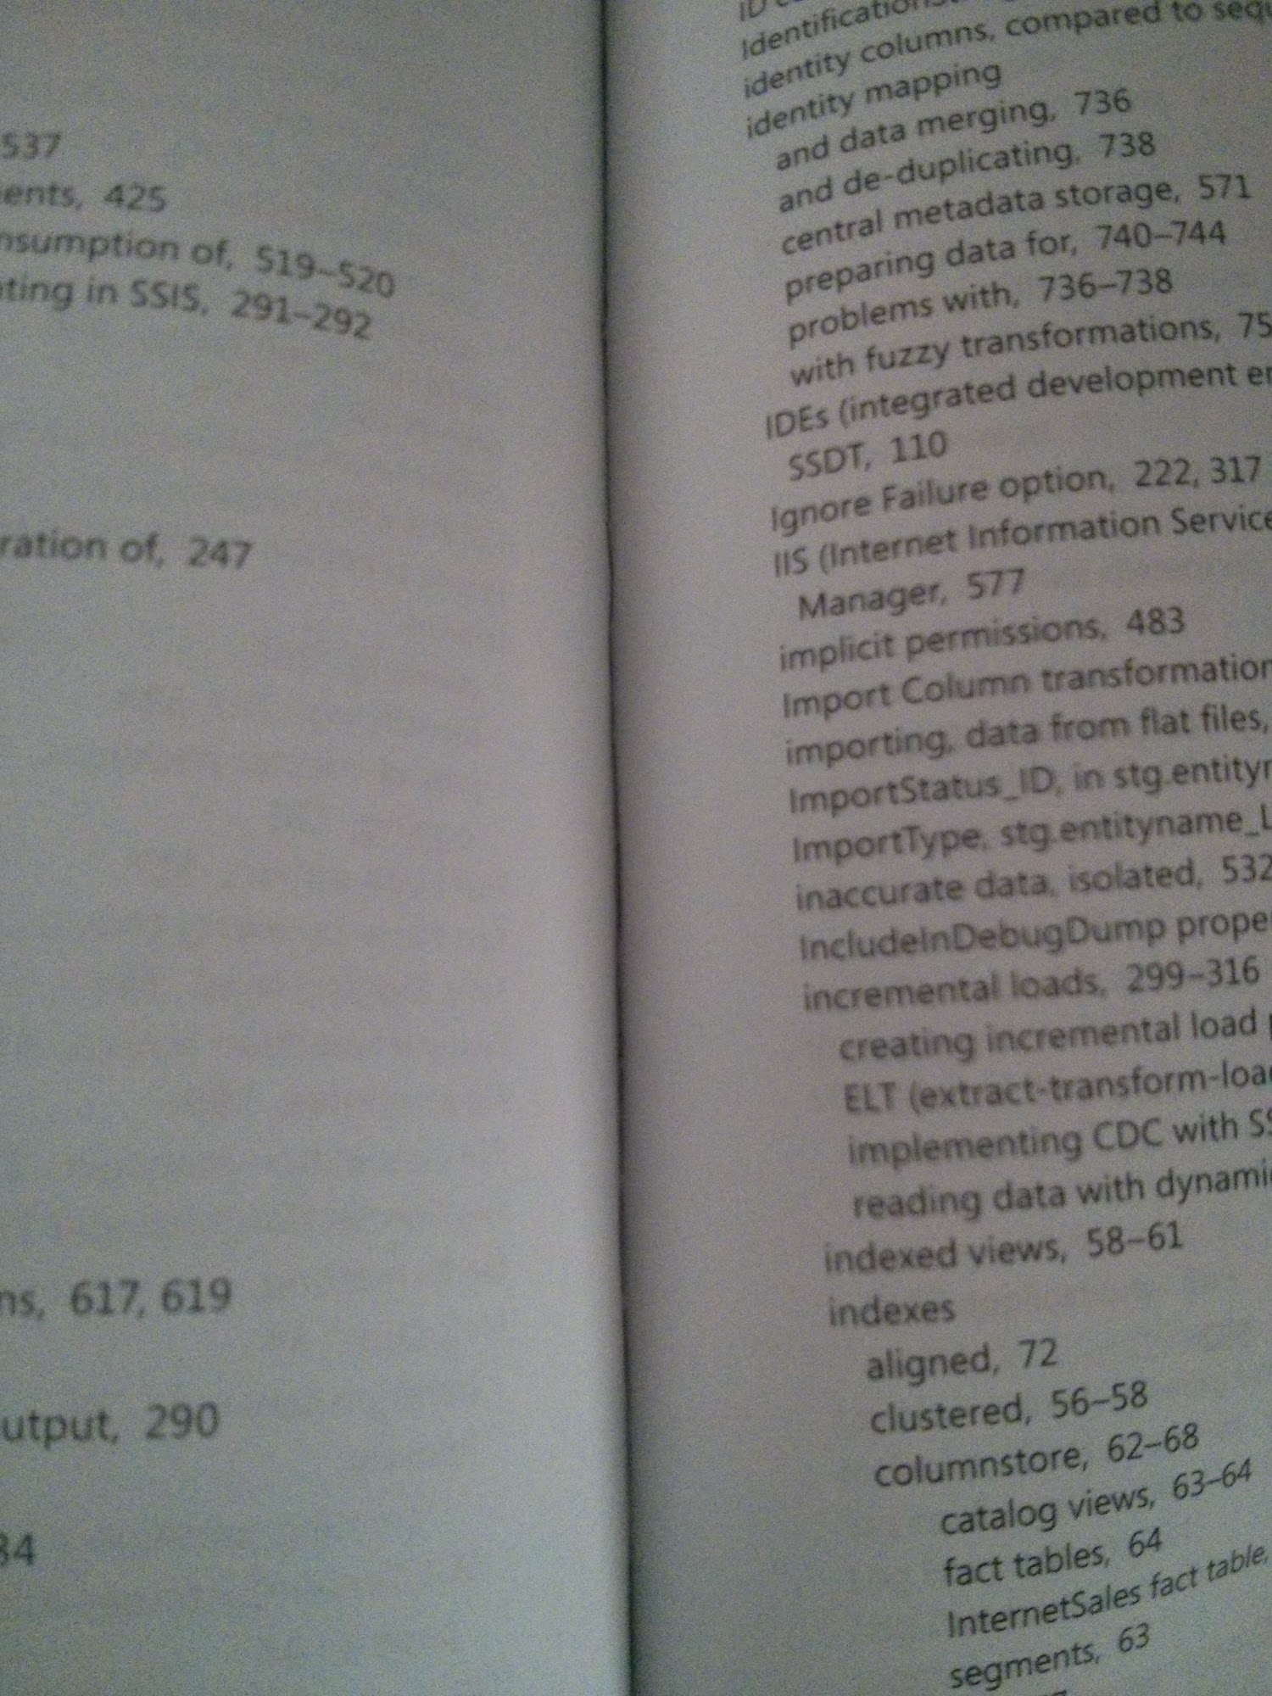

Slide 11
Creating Indexes
Demo - T-SQL and SSMS

Slide 12
Fragmentation
Occurs when pages in an Index "split"
1111 2222 3333 4444 5555 6666
For this example, data pages can only fit 6 records per page
Page Splits to accommodate new row since the other page was full
3334
1111 2222 3333
3334
4444 5555 6666
No page split since there is enough space
1111 2222 3333
3334
4444 5555 6666 6667 6668
6667 6668

Slide 13
Fragmentation
1111 1234 1235 1236 1237 2222
4444 5555 6666 6667 6668
Pages are now out of order and require maintenance.
1111 2222 3333
3334
4444 5555 6666 6667 6668
1234 1235 1236 1237
3333
3334

Slide 14
Fill Factor
Determines how full the index page will be upon creation (or after maintenance is done)
Default is set to 0 (i.e. 100% full)
Fill Factor is also known as density
Example: Set fill factor to 50, 50% of the page will be empty and reserved for new records
For this example, data pages can only fit 6 records per page
1111 2222 3333
4444 5555 6666
1111 2222 3333 4444 5555 6666
50% Fill Factor:
100% Fill Factor:

Slide 15
Padding
PAD_INDEX ON - applies fill factor to all layers of index (except the root)
By default this is off and fill factor only affects leaf nodes
Fill Factor will cause the index to use more space
In general, Fill Factor of 100% is useful for tables with very few data modifications

Slide 16
Index Maintenance
Essential to removing fragmentation and maintaining index performance
Rebuild
Basically, drops and recreates the index
Online available in Enterprise Edition
Reorganize
Reorganizes the index pages

Slide 17
Index Maintenance
Demo - T-SQL and SSMS

Slide 18
Benefits of Indexes
Faster record retrieval when done properly
Can separate Index from table on storage to improve performance
As a side effect they can help with Blocking transactions - data can be read from Covering Index and not have to touch base table
Can create indexes on views to further improve performance
Best for tables with little data modification

Slide 19
Drawbacks of Indexes
Takes up storage space
Can make inserts slower
Page splitting can cause fragmentation, which slows down indexes thus eliminating and advantages
Over-indexing or using columns with poor selectivity (example would be Gender)
*Selectivity is also known as density and is a value measured between 0-1, lower than 0.1 being an index with good selectivity

Slide 20
Future topics to continue with
Covering Indexes and Include Columns
Filtered Indexes
Indexed Views
Column-Store Indexes
Datawarehousing/ETL and Indexing

Slide 21
Questions/Comments
Thank you for attending! Slides and code will be on my website
www.TheSQLPro.com/Presentations
Please feel free to connect with me @TheSQLPro
www.LinkedIn.com/in/aymansqldba

